Slide 1
Dog Kennel Hill
Comparing air pollution on routes to school

Slide 2
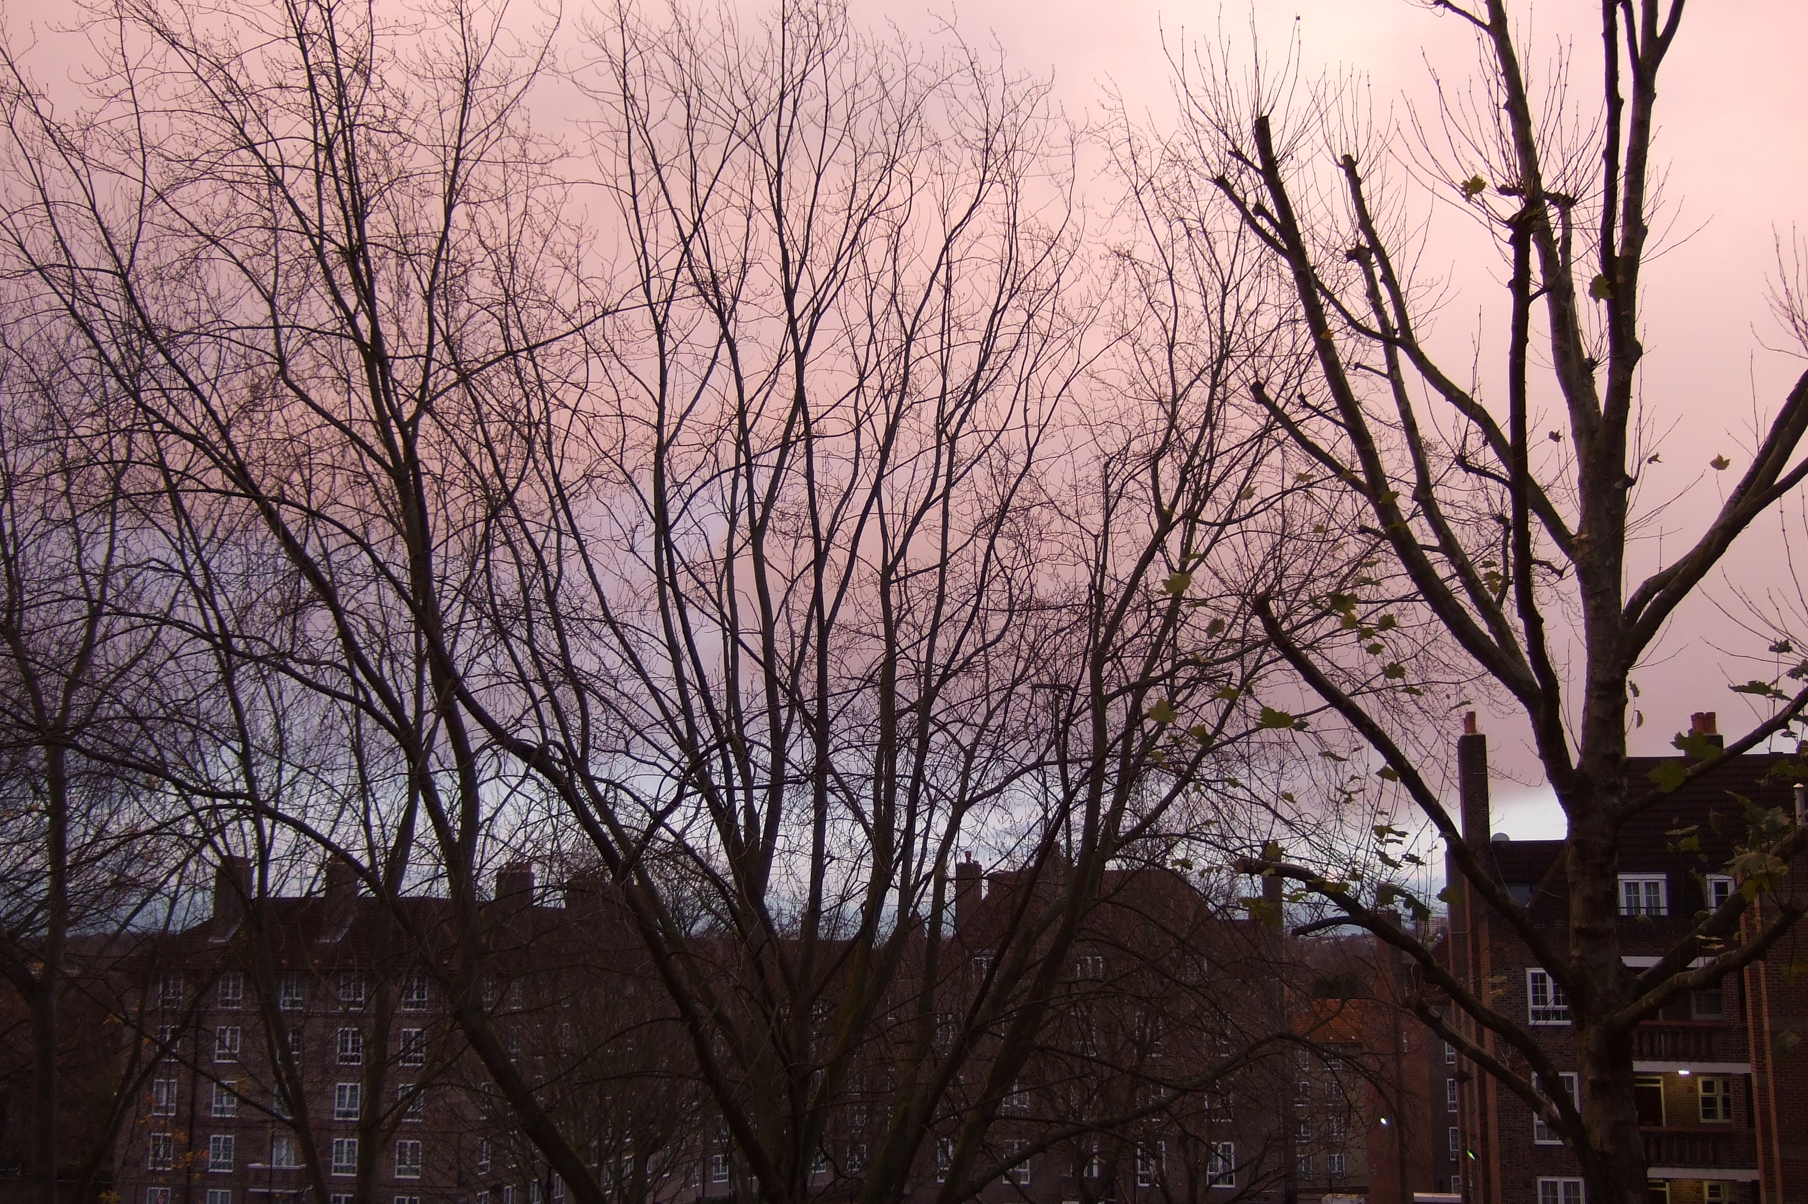

Slide 3
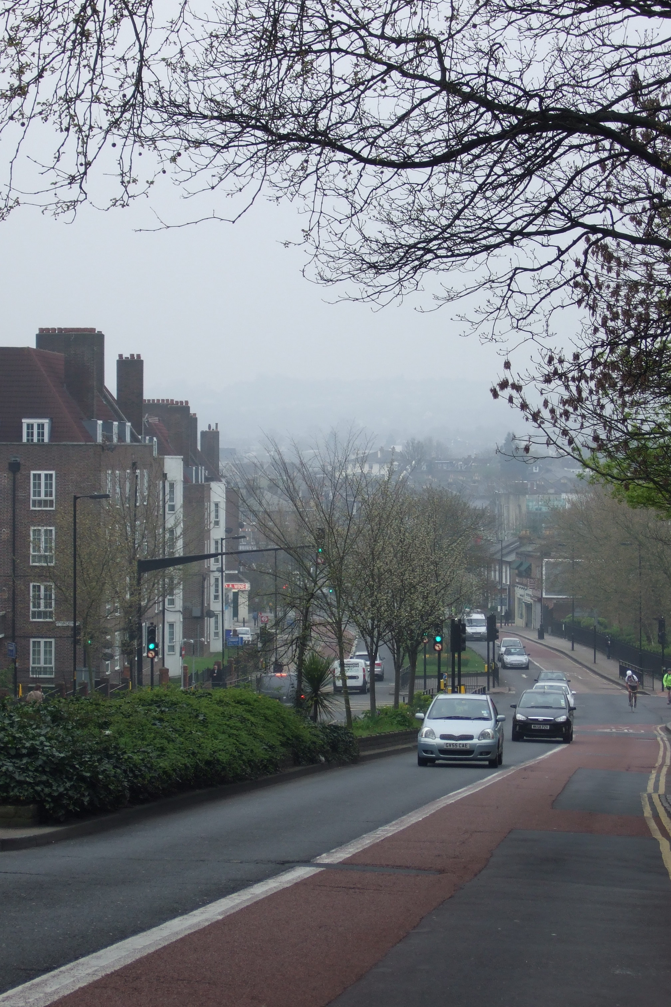

Slide 4
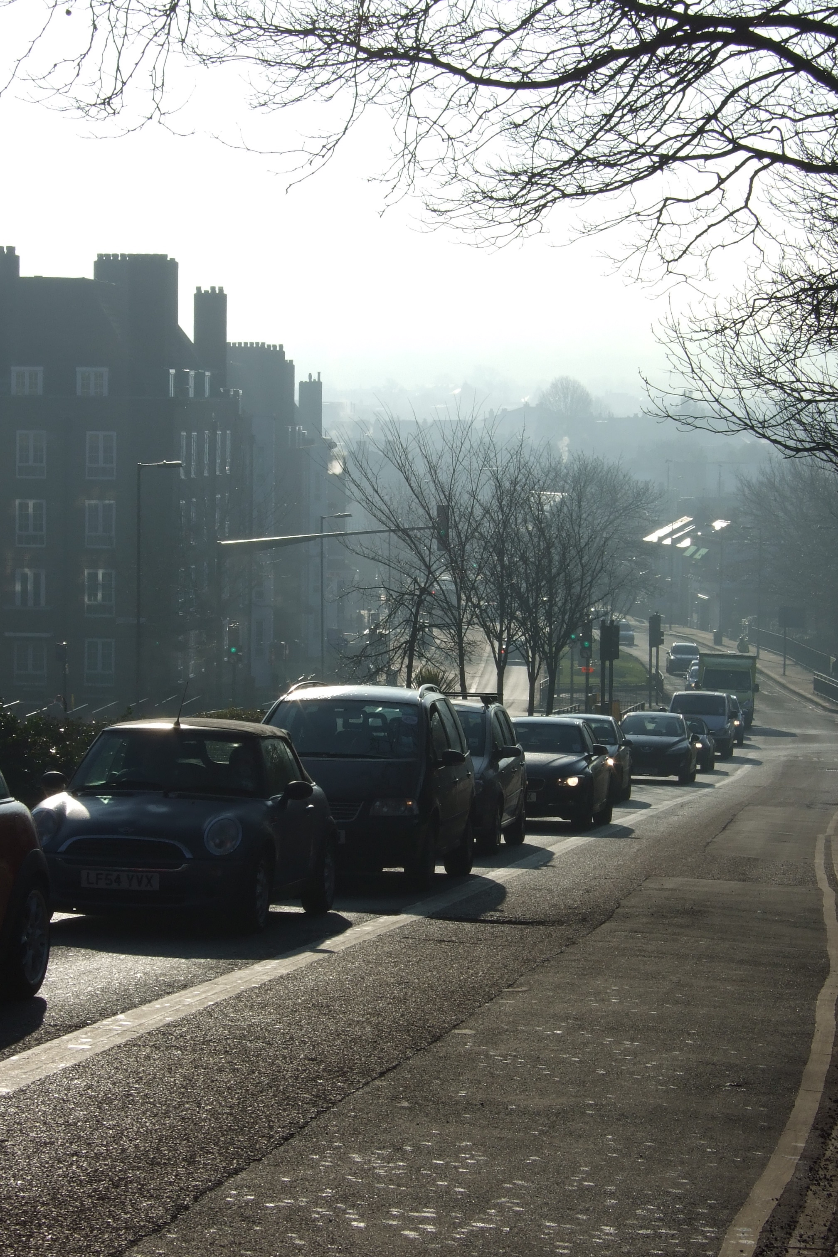

Slide 5
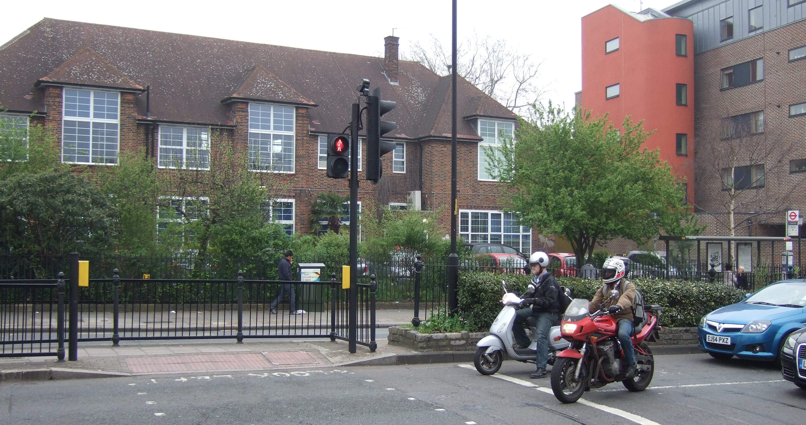
Dog Kennel Hill School

Slide 6
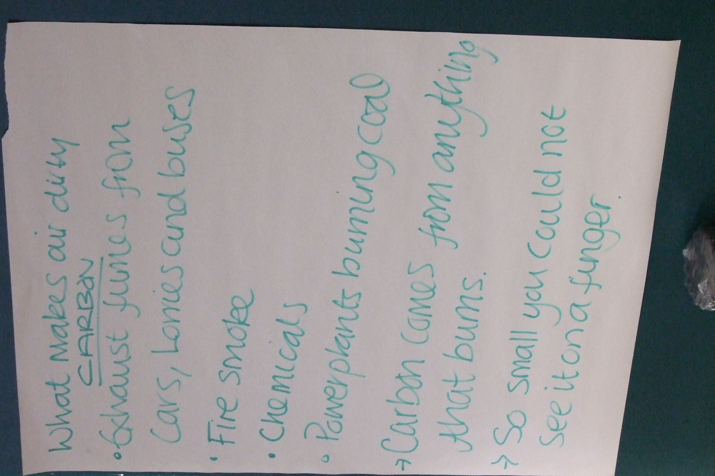

Slide 7
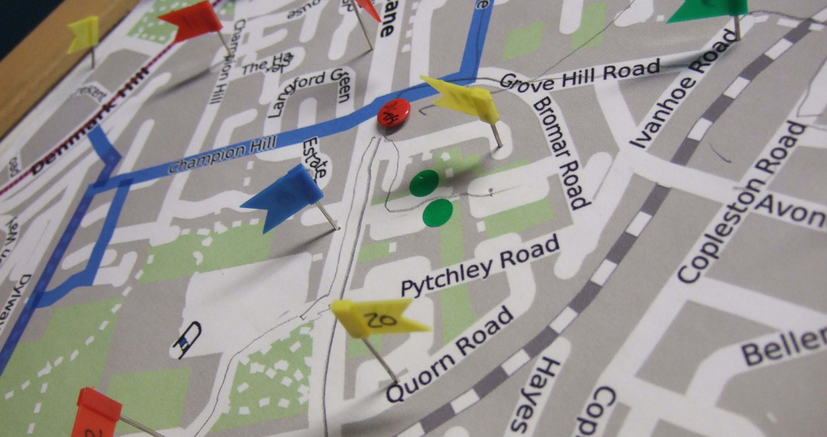
Mapping home to school

Slide 8
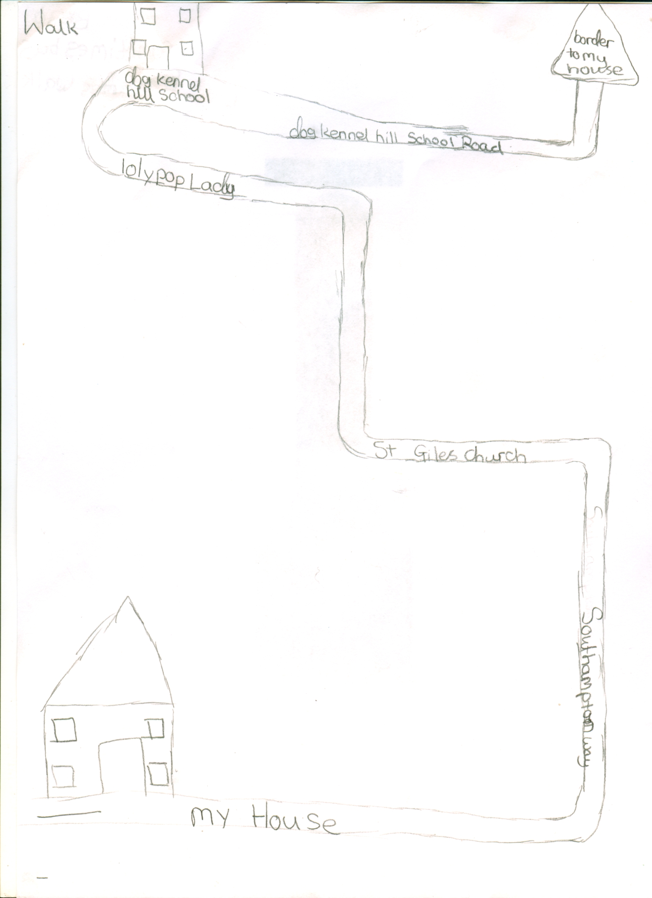

Slide 9
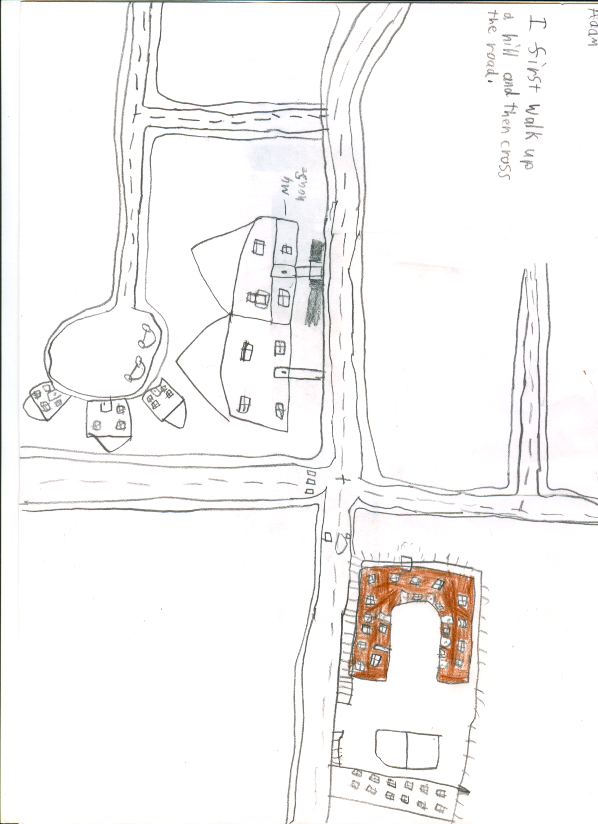

Slide 10
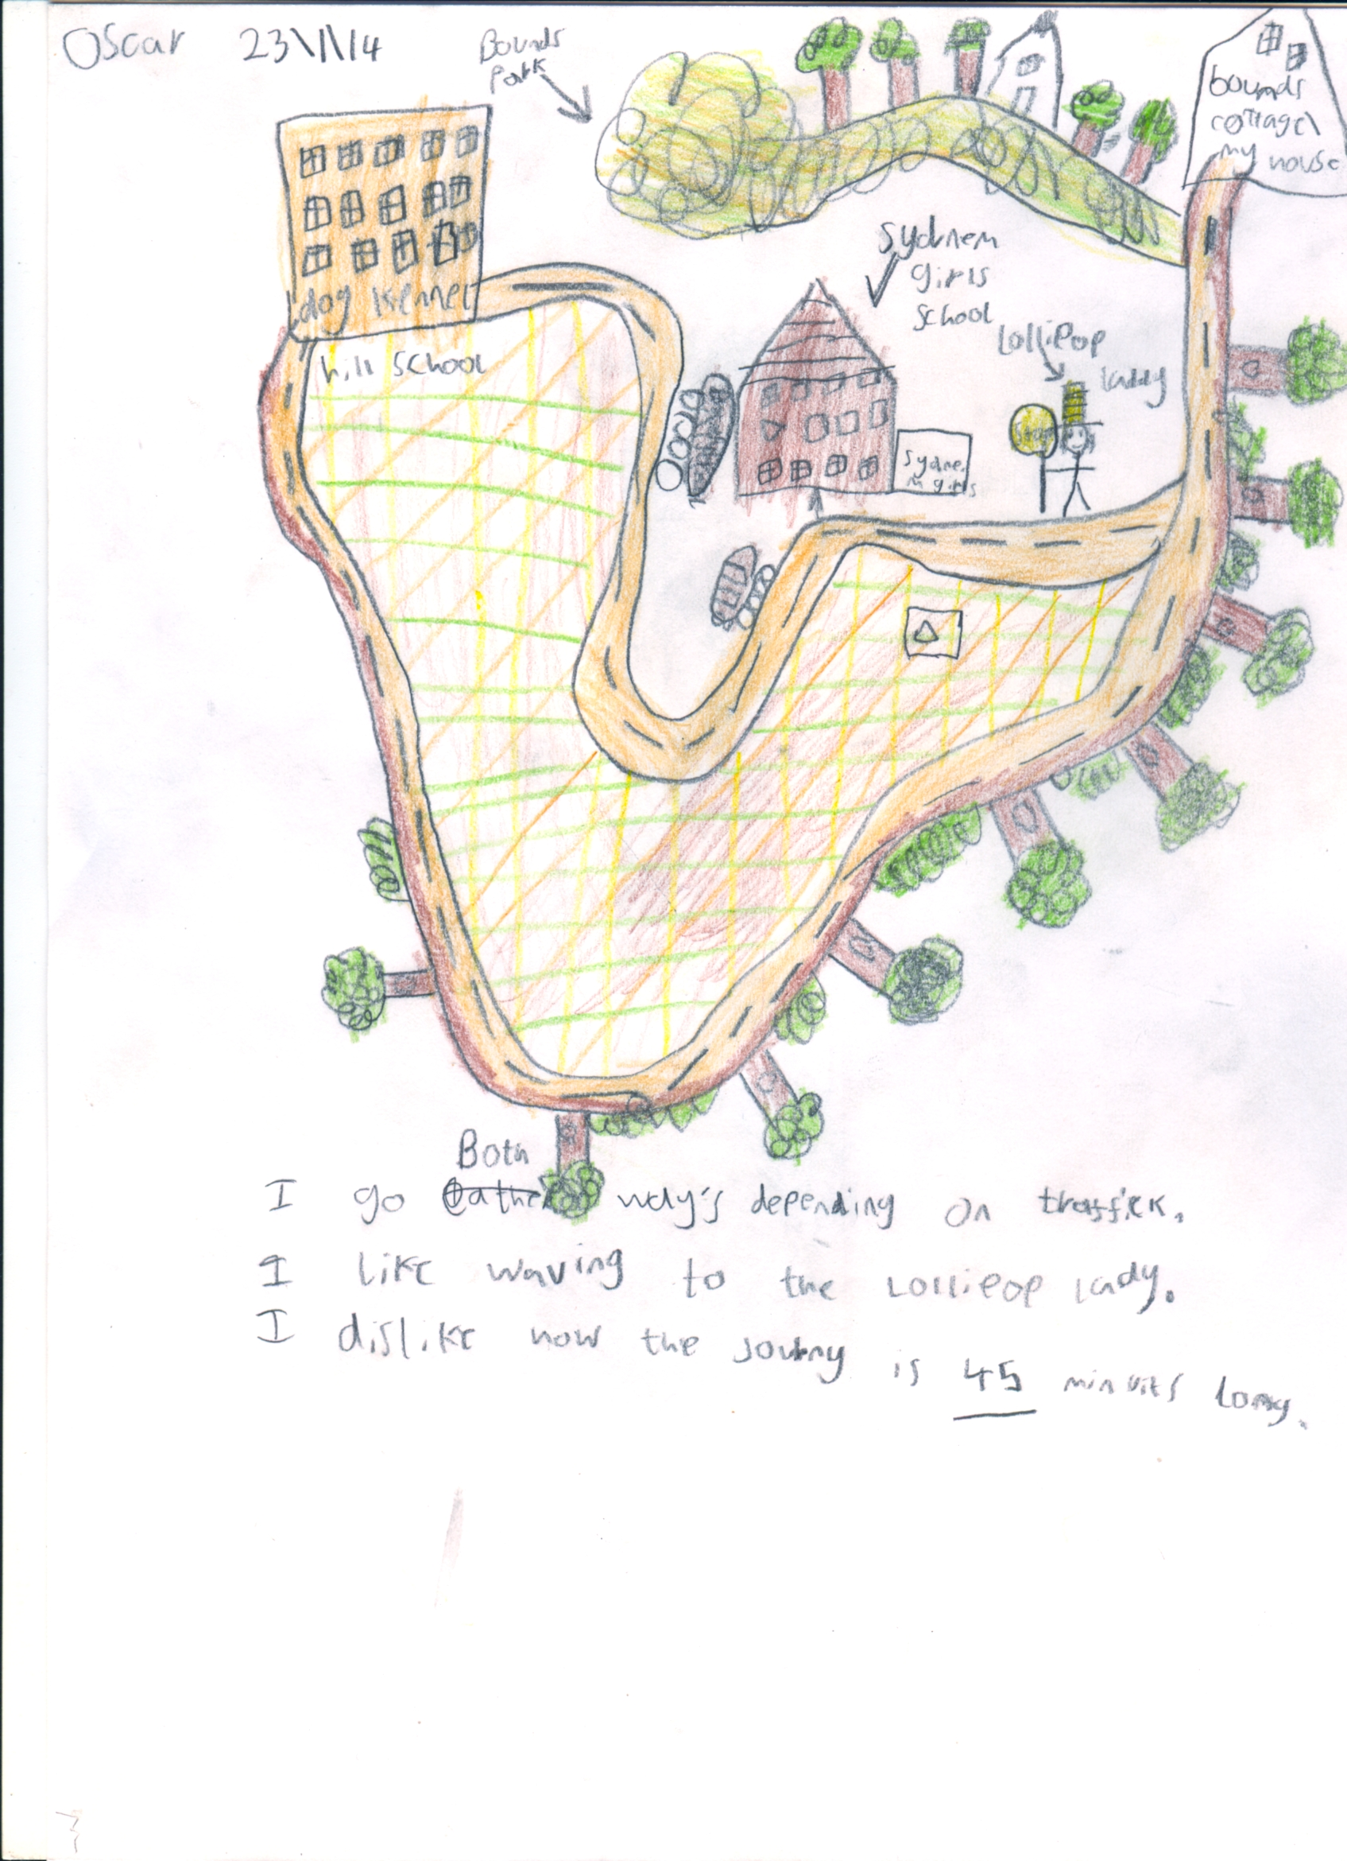
Oscar: I go Both way’s depending on traffick.
I like waving to the lollipop lady.
I dislike now the journy is 45 minuits long.

Slide 11
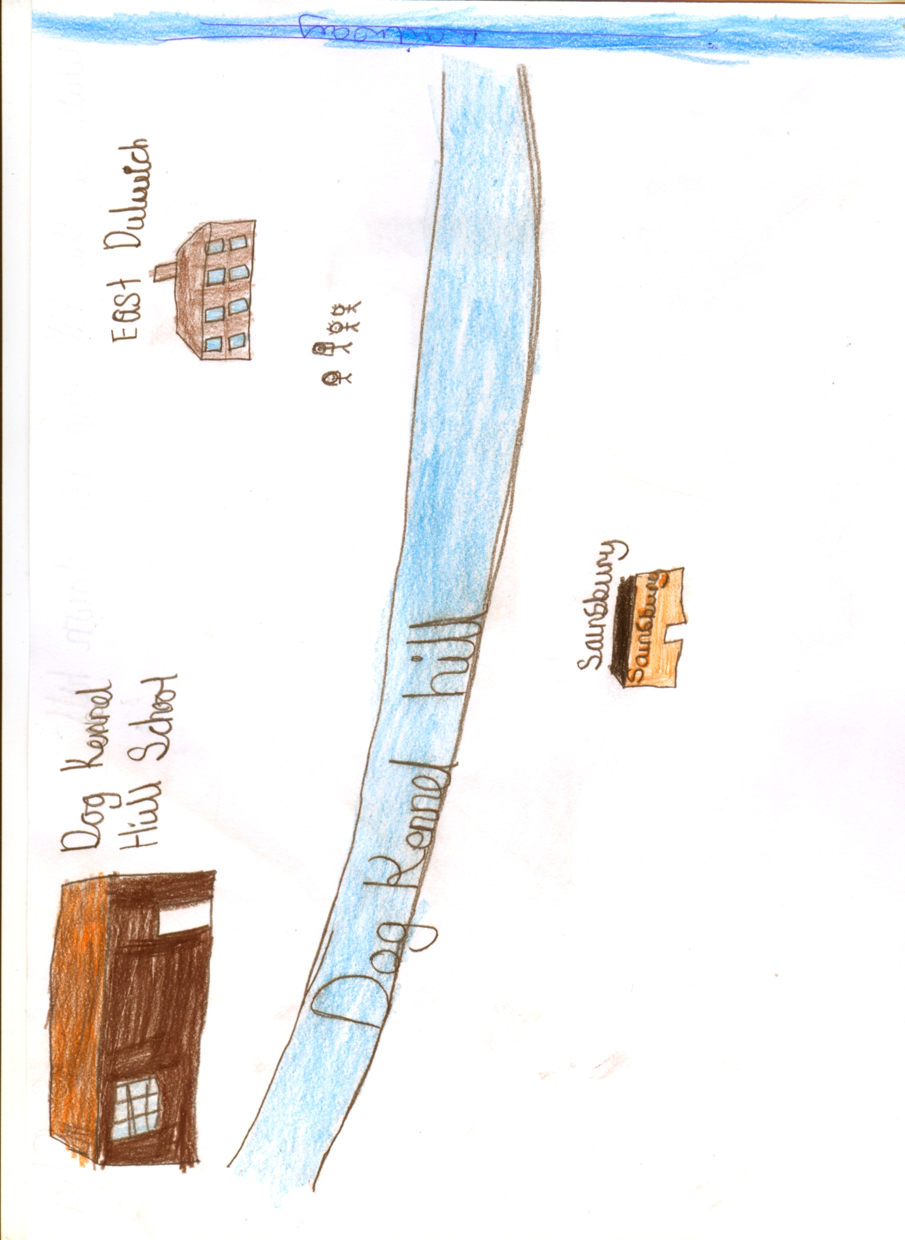
This child has a three-minute walk from the East Dulwich Estate to school

Slide 12
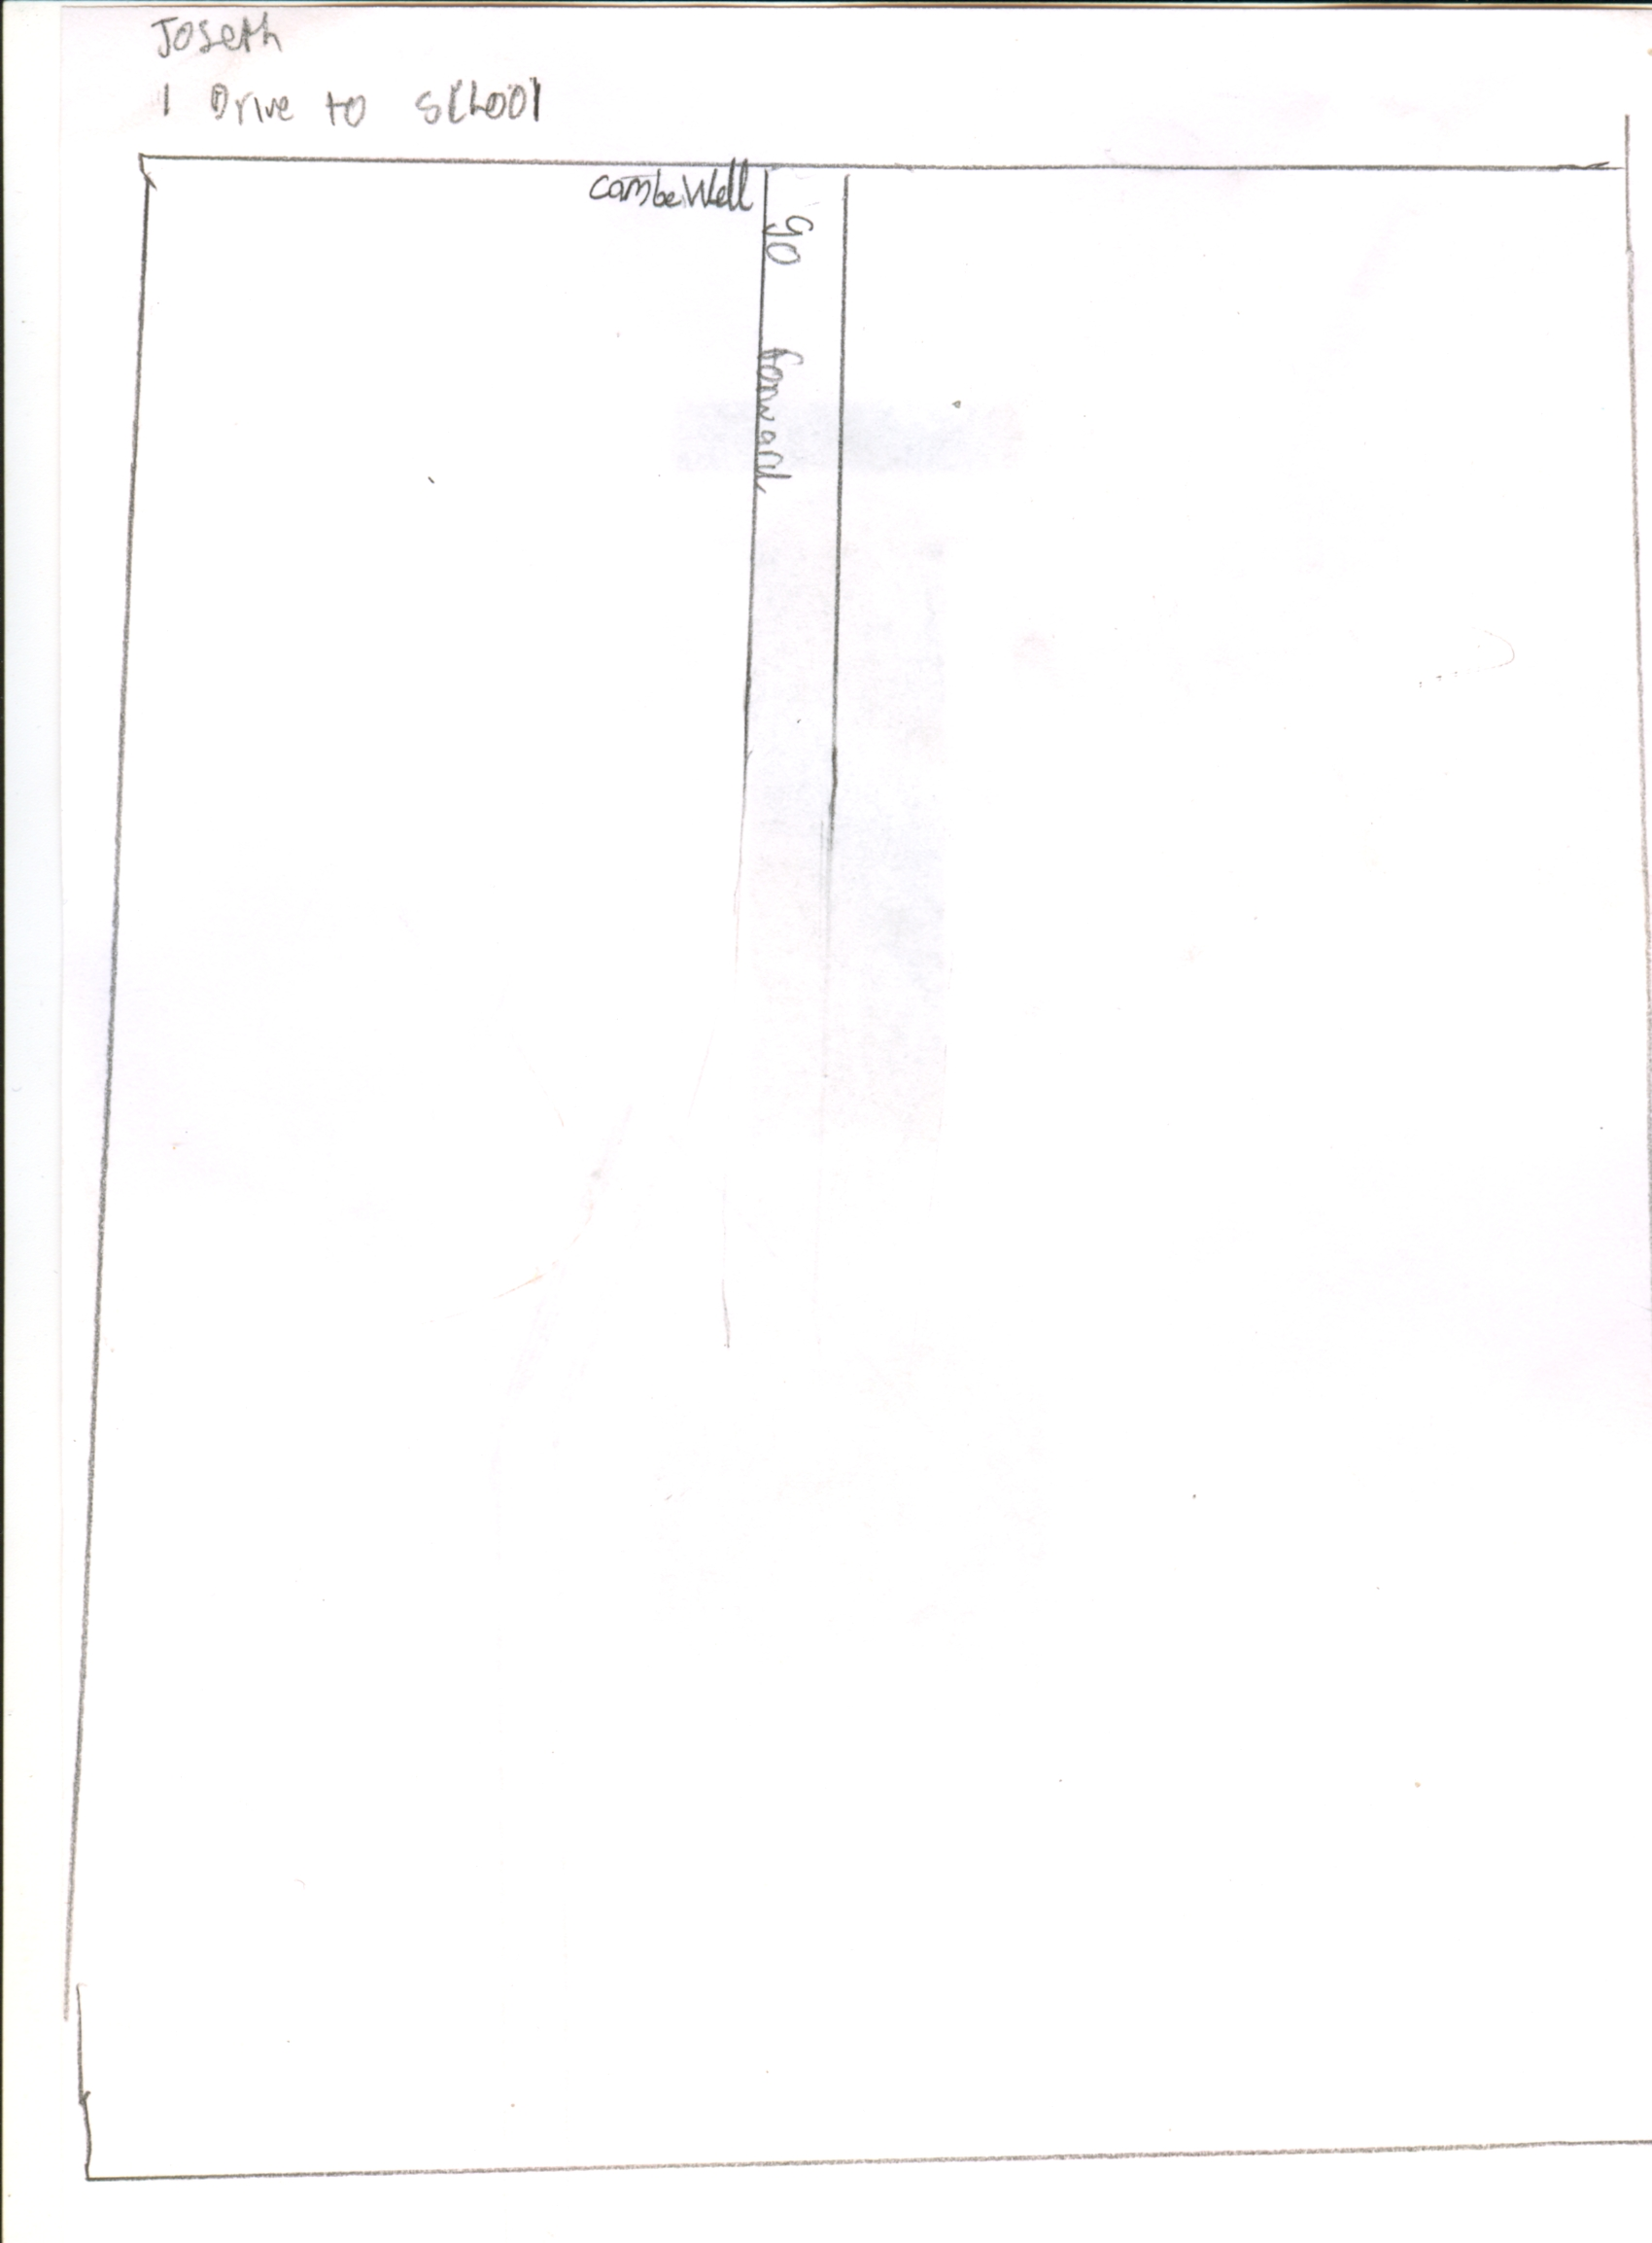
Joseph: I Drive to school

Slide 13
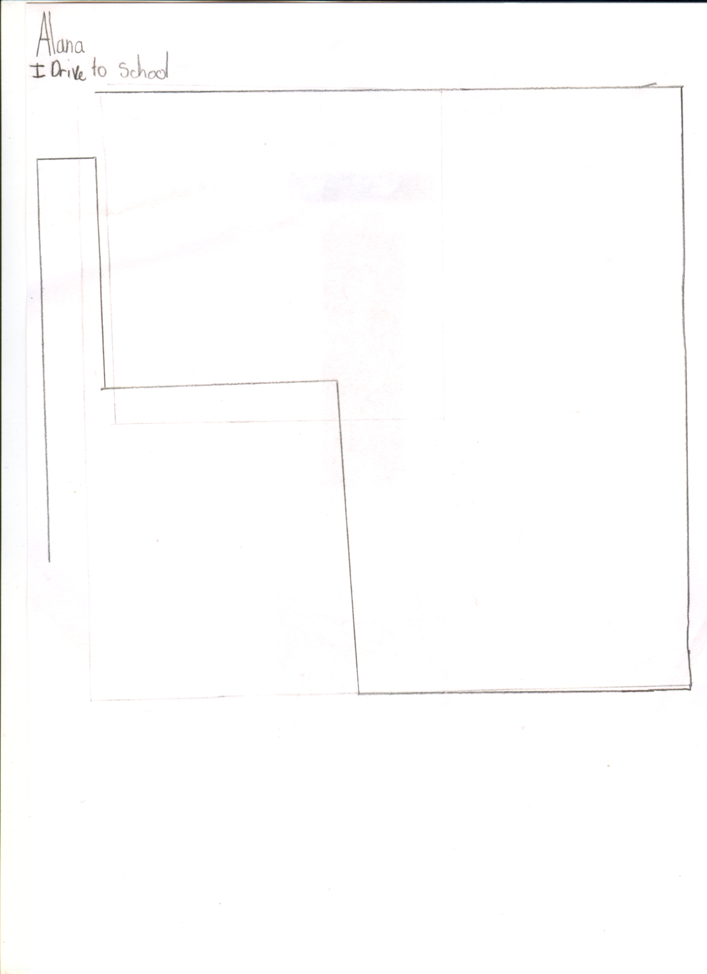
Allana: I Drive to School

Slide 14
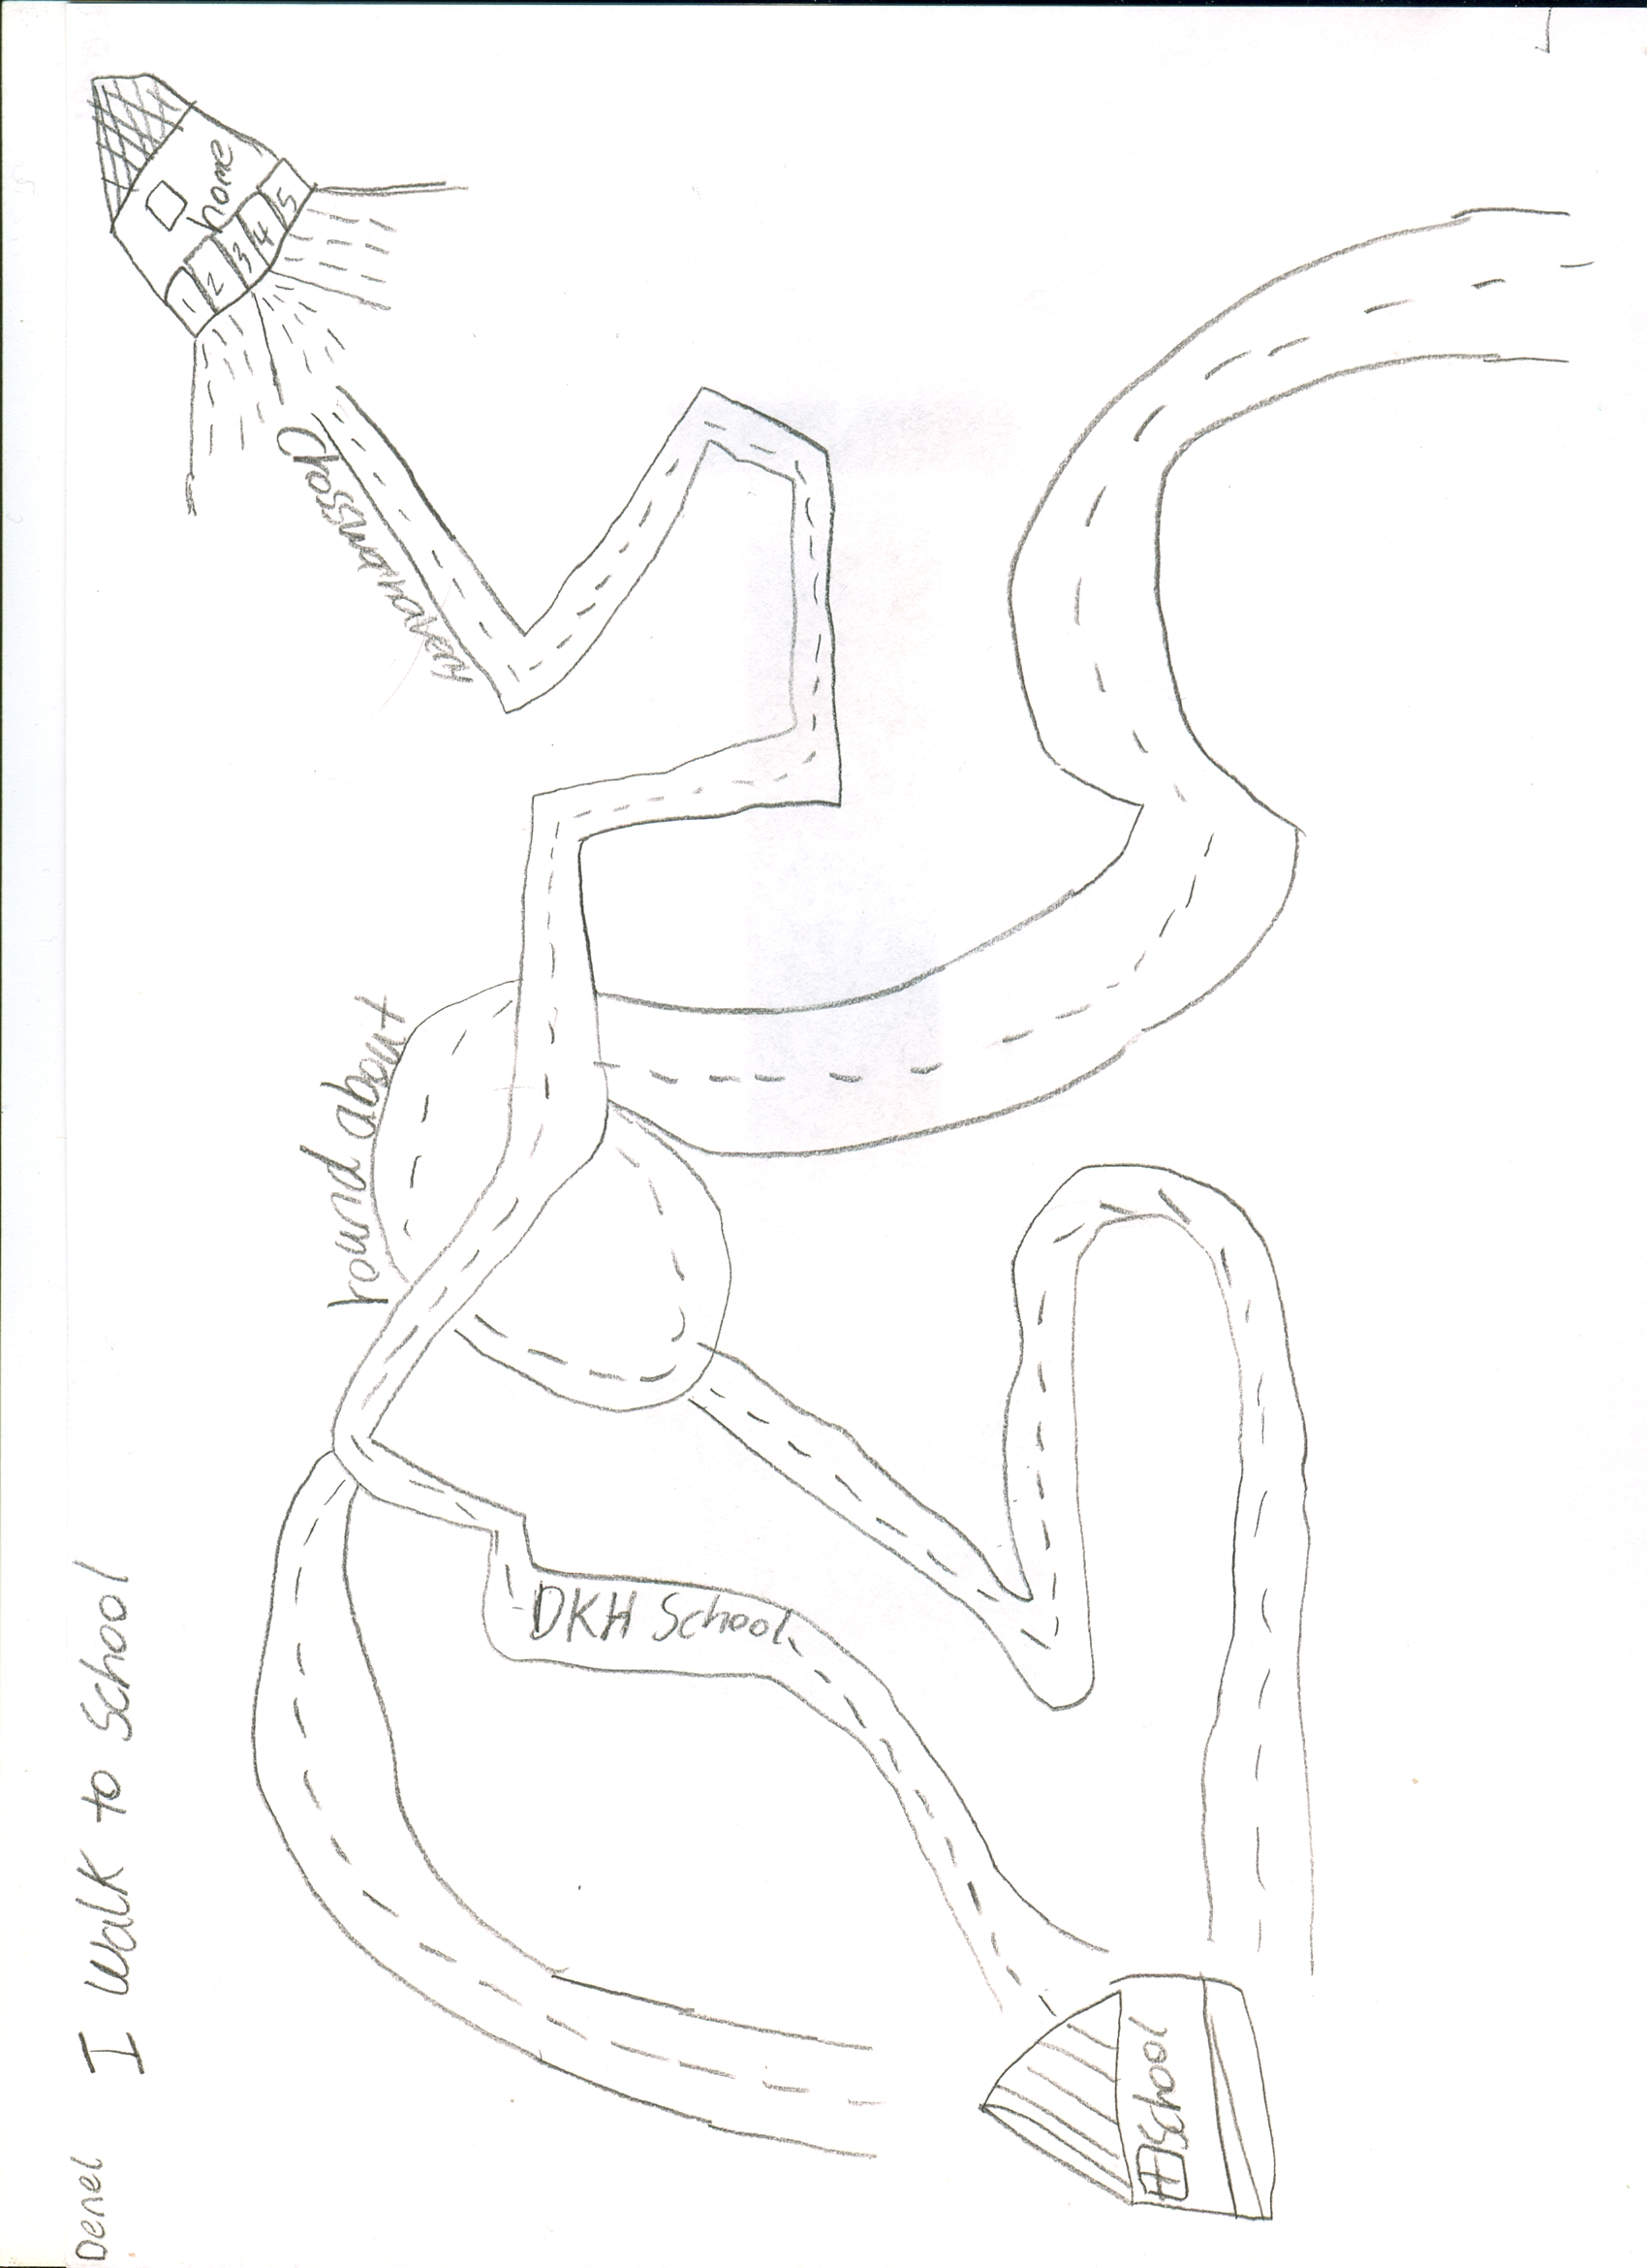
Notes:
<number>

Slide 16
Left: following bus route along Lordship Lane
Right: along residential back streets

Slide 17
School to Melbourne Grove

Slide 18
Left: following 185 bus route down Denmark Hill, past King’s College Hospital to Camberwell Green and Camberwell New Road
Right: along residential streets, through Ruskin Park, crossing Coldharbour Lane.

Slide 19
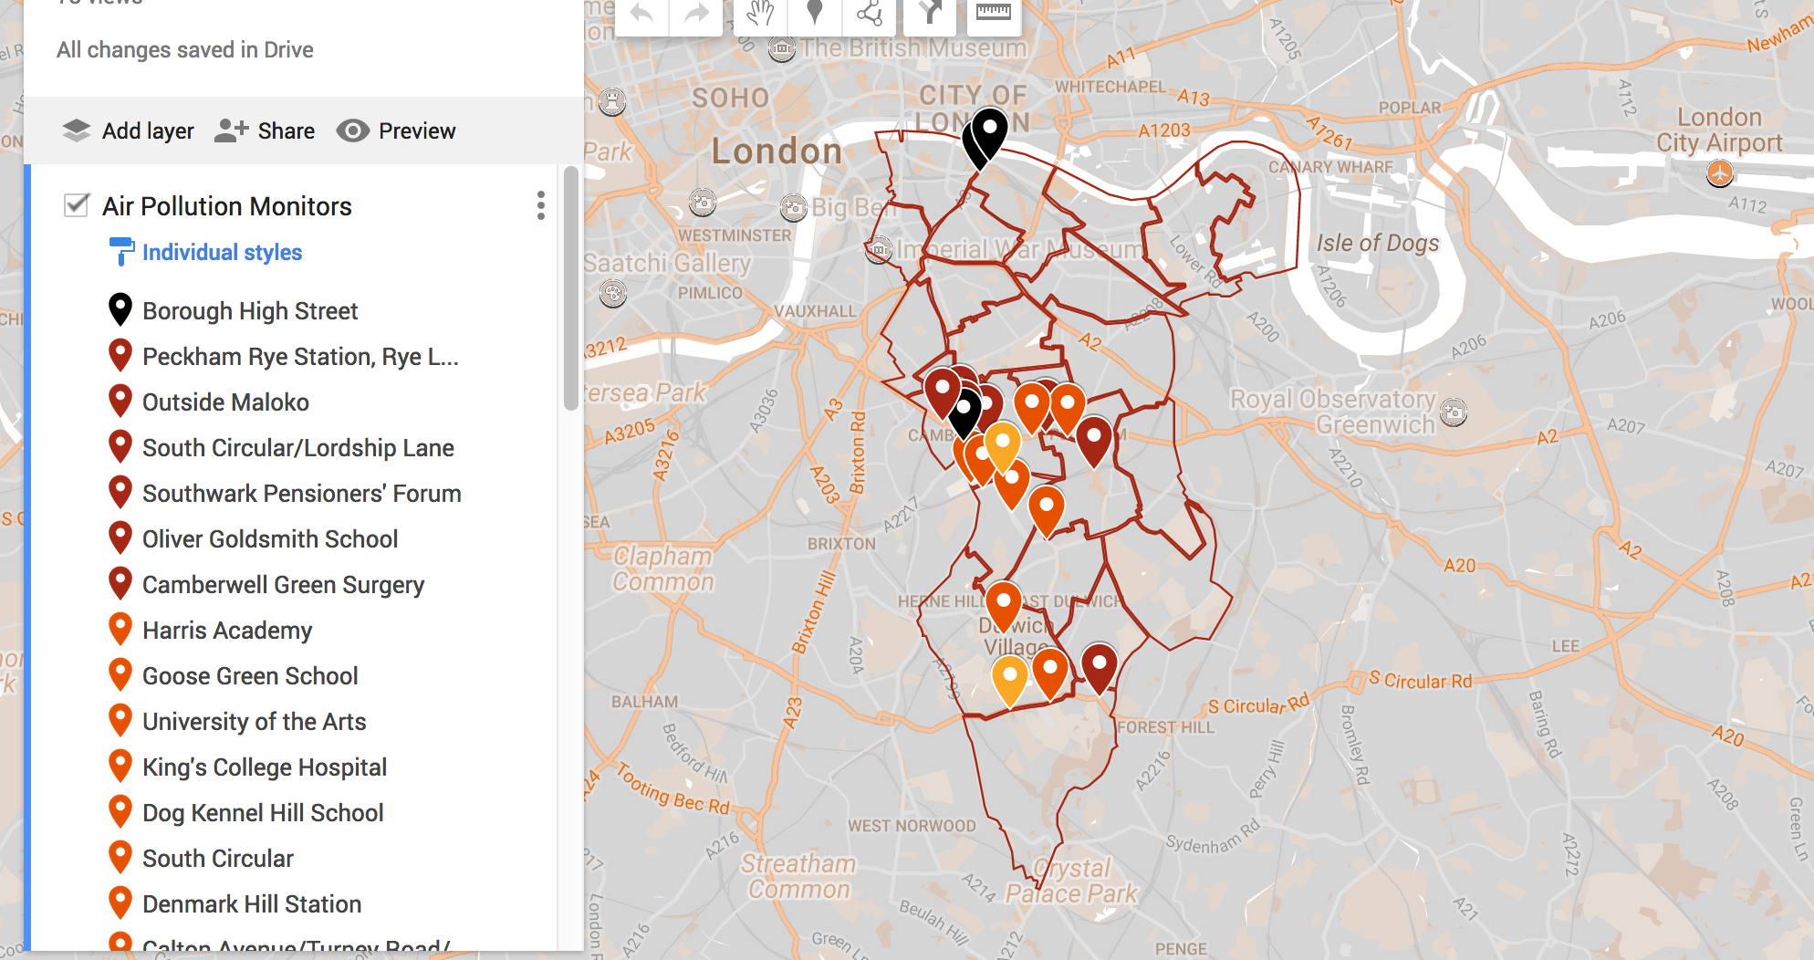
NO₂ monitoring 2017

Slide 20
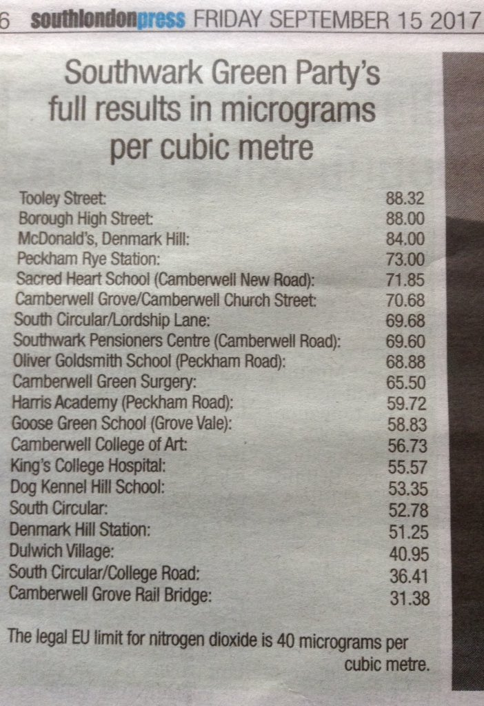

Slide 22
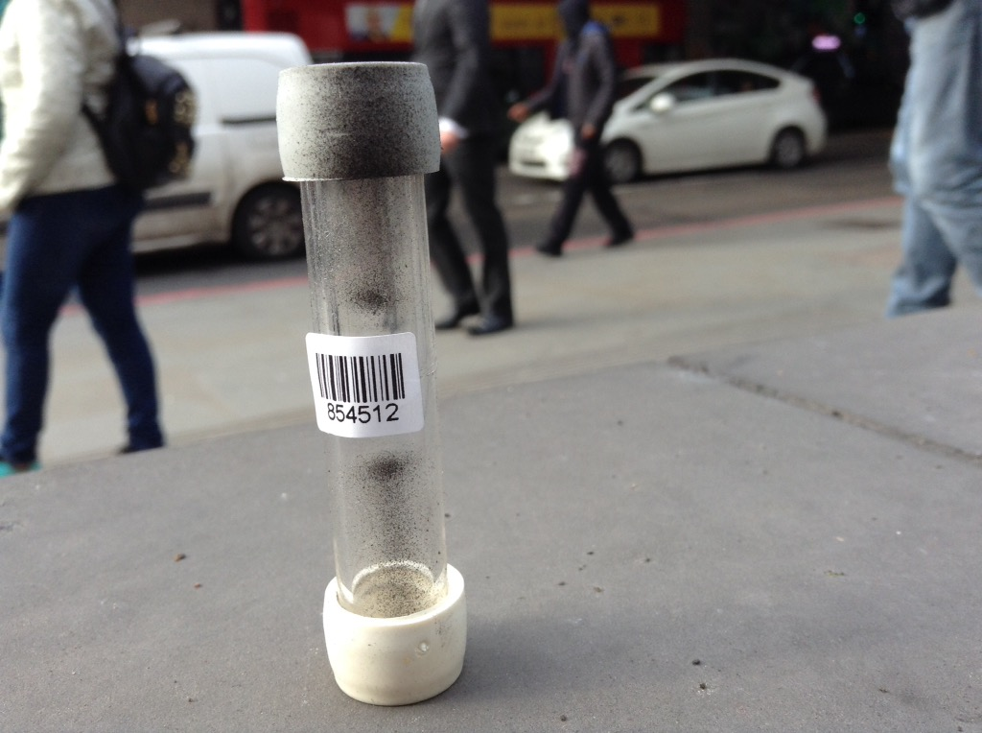
Eleanor Margolies
East Dulwich Estate Regeneration Project Team
emargolies@gmail.com

